Slide 1
The Game Engine of the Future
Mike Acton
macton@insomniacgames.com
Twitter: @mike_acton

Slide 2
Why am I here?

Slide 3
Say anything you want.

Slide 4
It’s all about the data.

Slide 5
THE END.

Slide 6
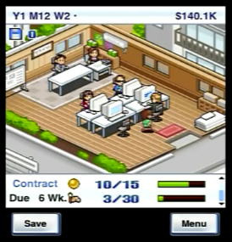
Game dev story

Slide 7
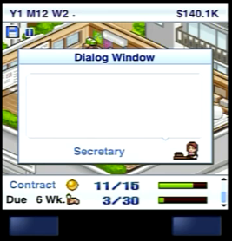
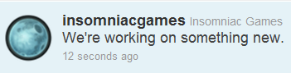

Slide 8
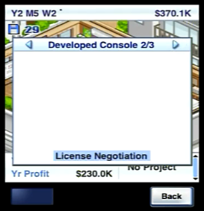
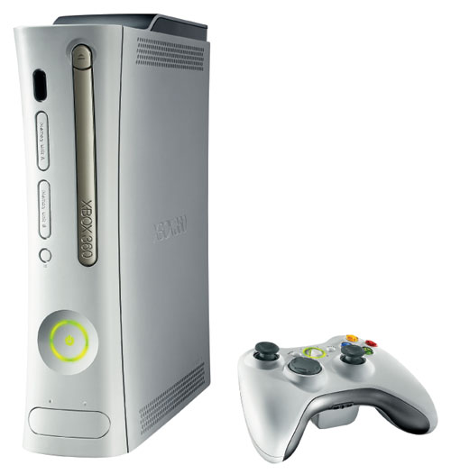


Slide 9
Lots of big changes. What are you going to do?

Slide 10
Shared my personal vision with team.

Slide 11
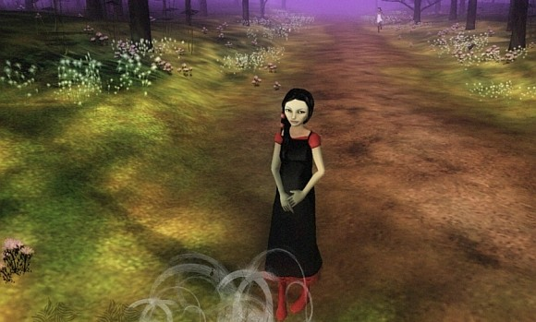
The Path

Slide 12
Why?

Slide 13
For the money?

Slide 14
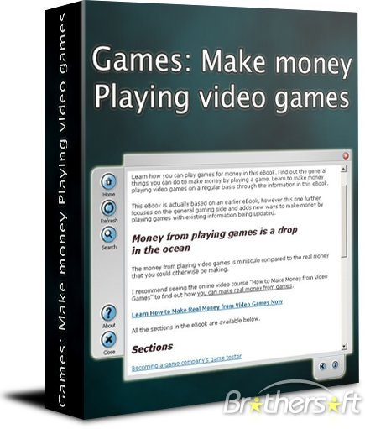

For the money?

Slide 15
For the fame?

Slide 16
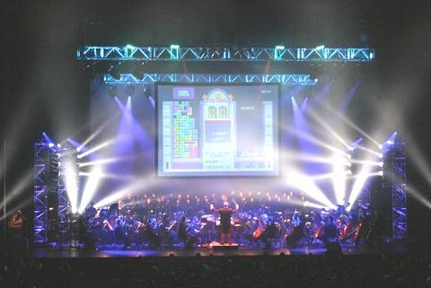
For the fame?

Slide 17
For the girls?

Slide 18
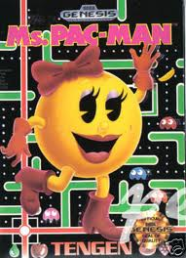
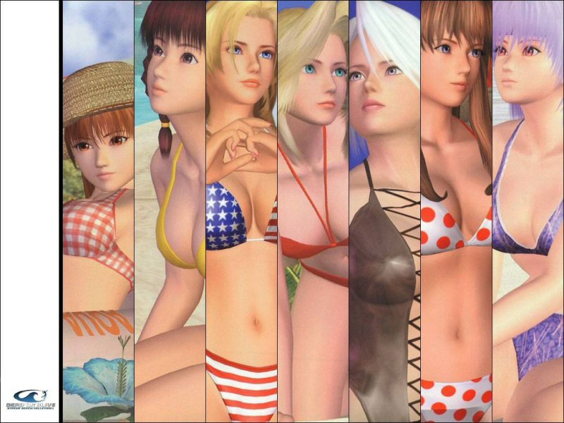
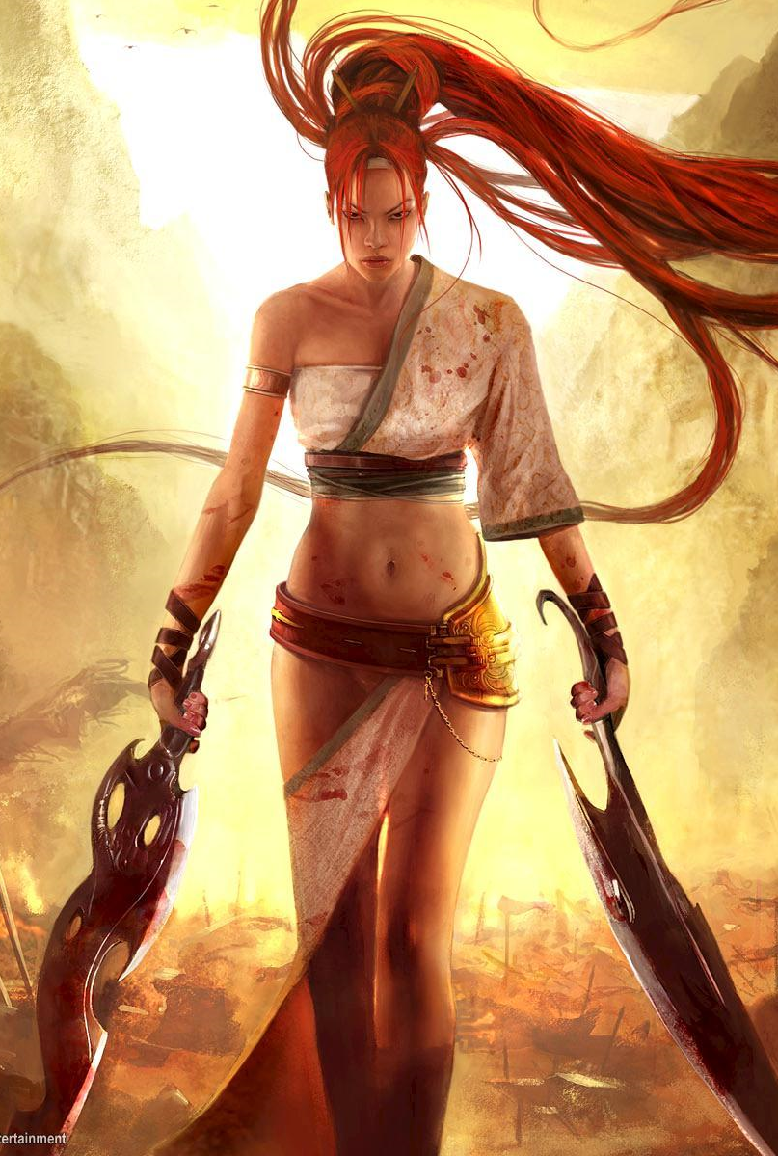
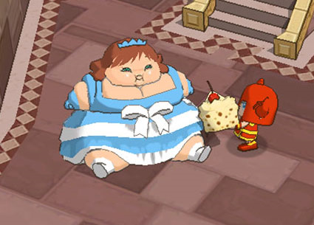
For the girls?

Slide 19
Creation Ego?

Slide 20









Creation Ego?

Slide 21
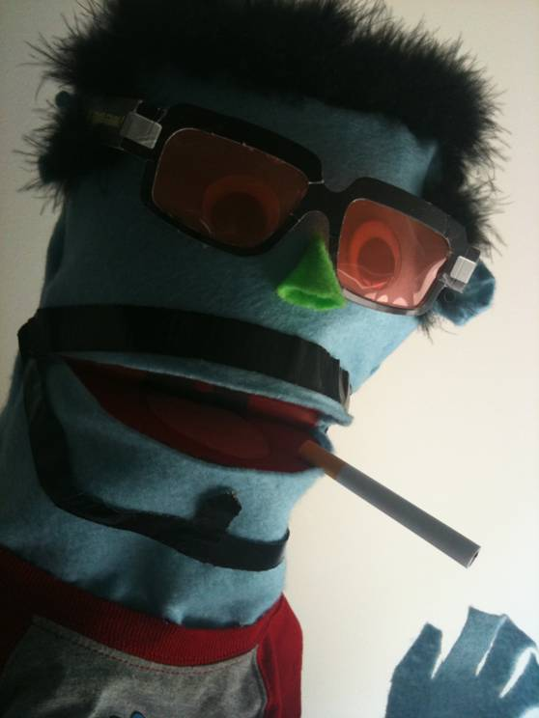
Mike Acton Presents: Mike Acton’s Vision of The Engine of The Future Presented by Mike Acton
Maybe a little…

Slide 22
What do I believe?

Slide 23
Games are Important.

Slide 24
I believe games make a difference.

Slide 25
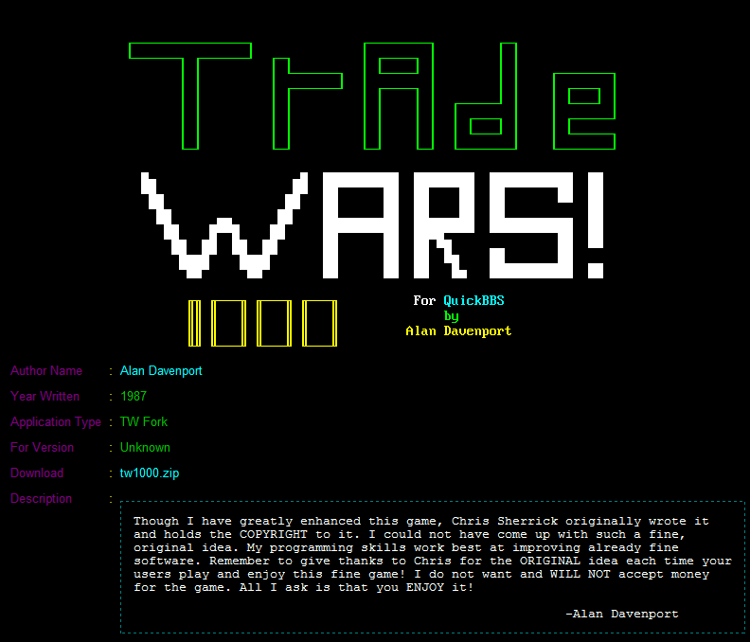

Slide 26




Slide 27


Slide 28
I believe games are art

Slide 29
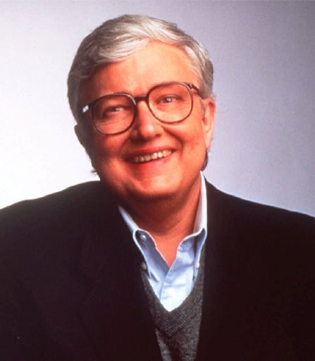
Games are not art!

Slide 30

Full of Shit*
*About video games

Slide 31
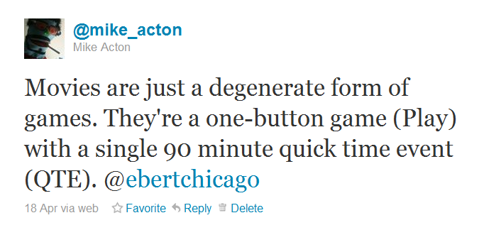

Slide 32

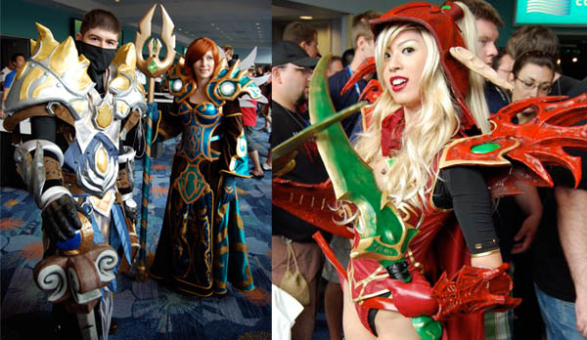
Participatory Fantasy

Slide 33
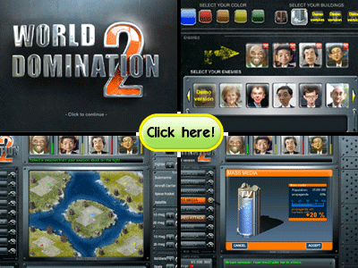
Augmented Dreams

Slide 34
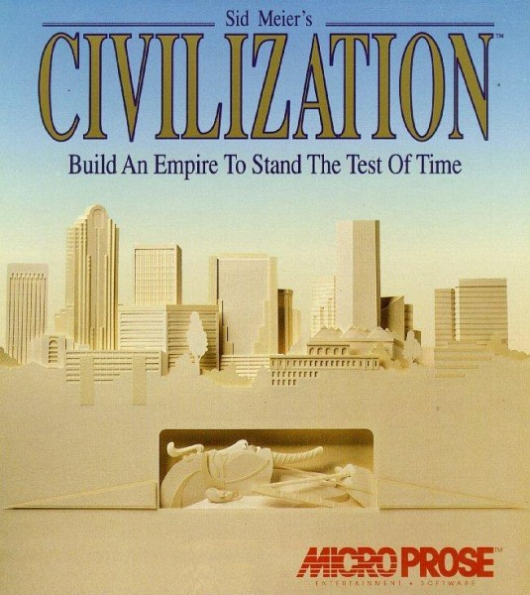
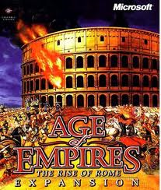
Augmented Dreams

Slide 35
Augmented Dreams
Other dreams?

Slide 36

Interactive Creativity

Slide 37
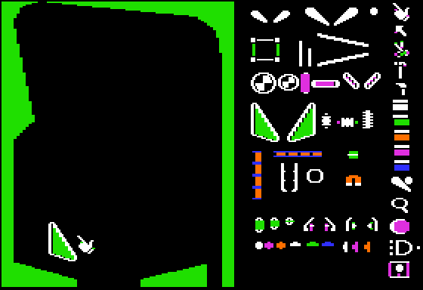
Interactive Creativity
Pinball Construction Set (1983)

Slide 38
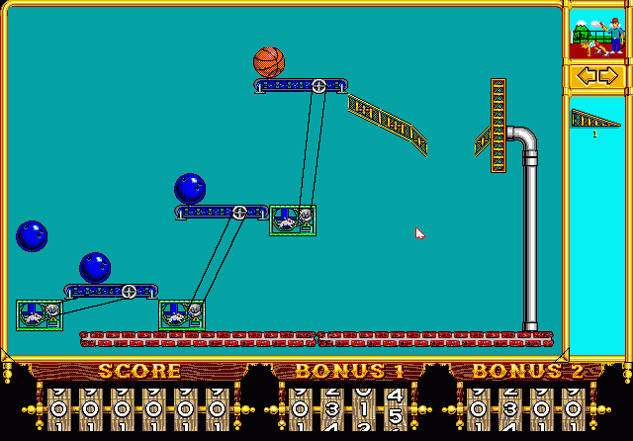
Interactive Creativity
The Incredible Machine (1992)

Slide 39

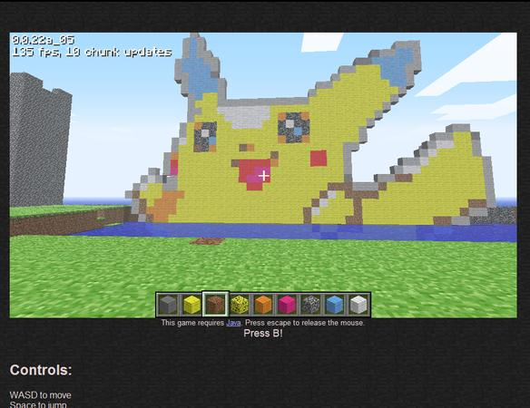
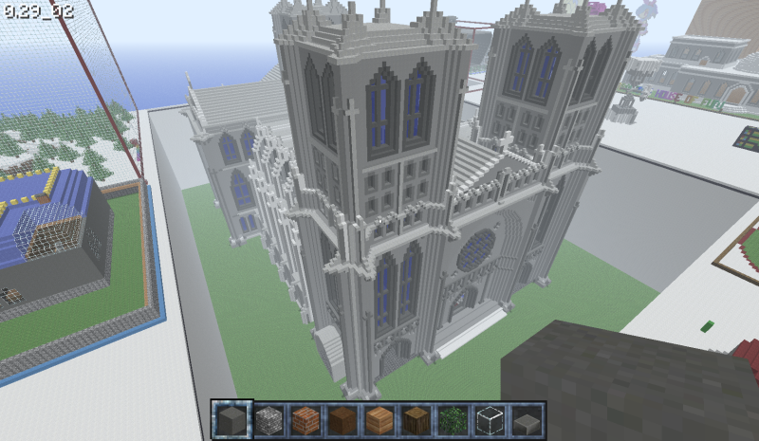
Interactive Creativity

Slide 40
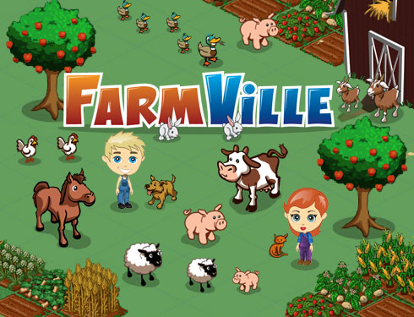

Slide 41
I believe in games as pop

Slide 42
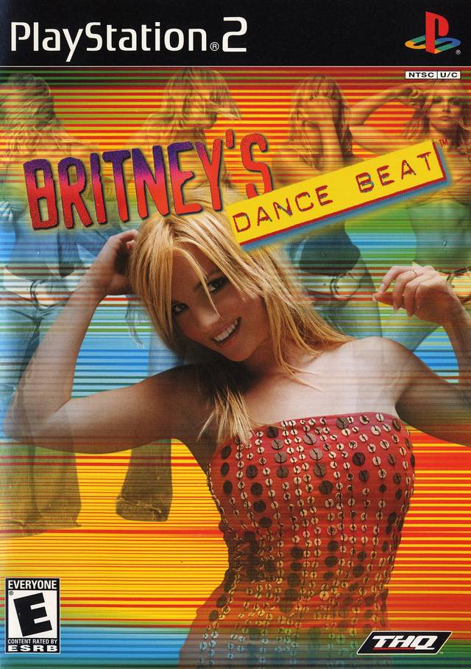

Slide 43
Business vs. Art

Slide 44
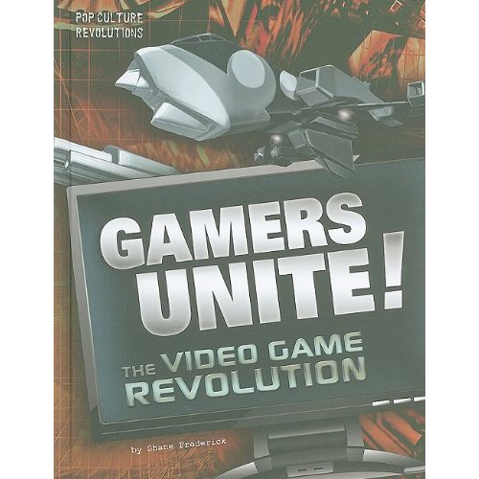

Slide 45
Innovation != Sales
Don’t get hung up…

Slide 46
Innovation != Sales
(Radical)

Slide 47
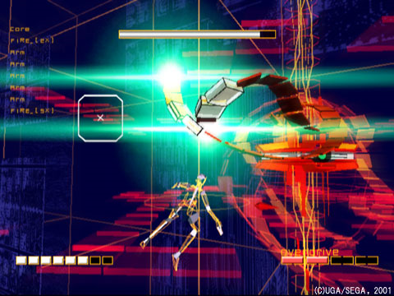
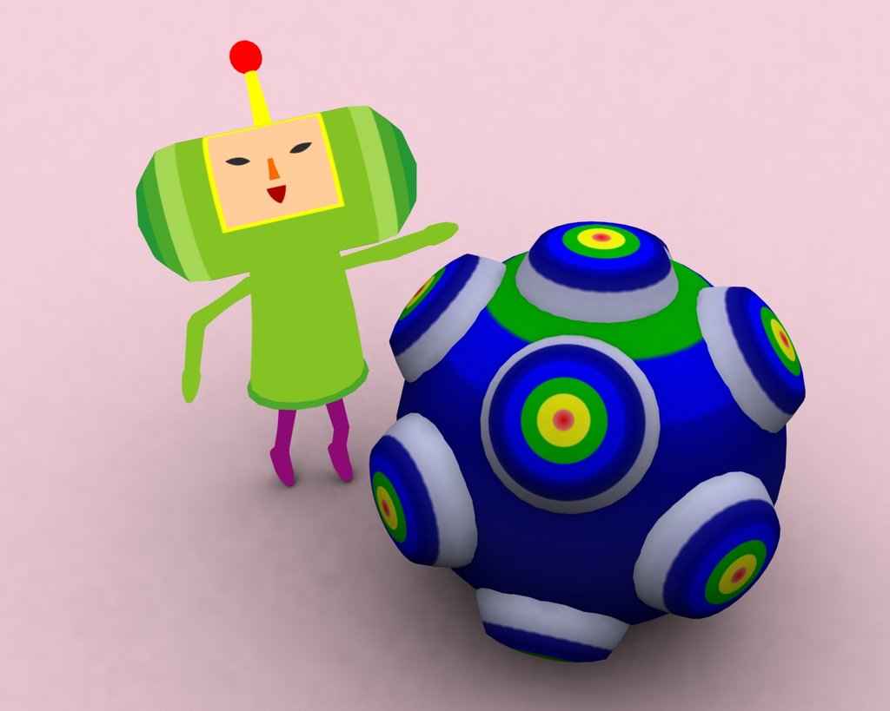
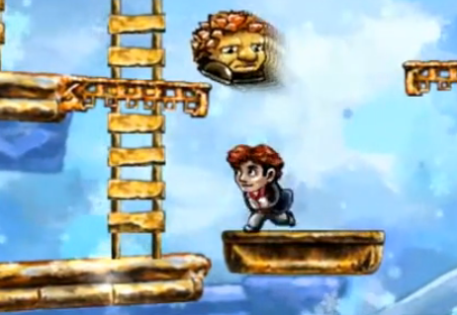
Rez
Katamari Damacy
Braid

Slide 48
Are we short-sighted?

Slide 49
Are we short-sighted?
Only sometimes. Mostly impatient.

Slide 50
Innovation by degrees
(Many games theory)

Slide 51

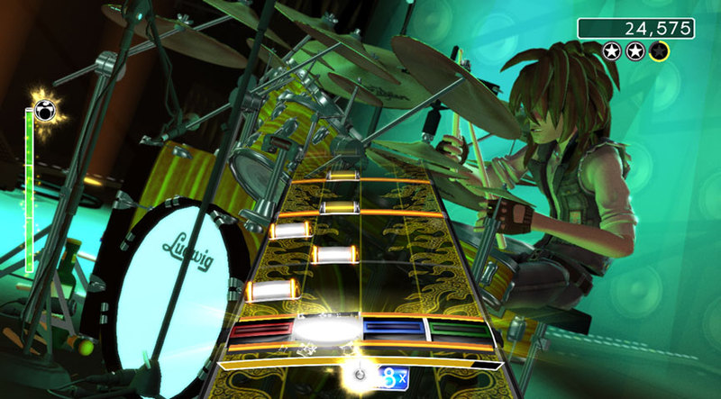
Parappa the Rapper
Rock Band

Slide 52
Business + Art

Slide 53

The Art of Pop
Production value matters…
Marketing matters…

Slide 54
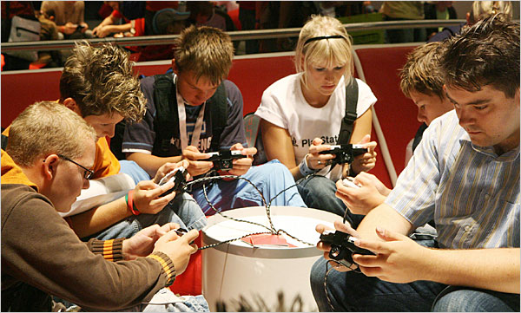
Players Matter.

Slide 55
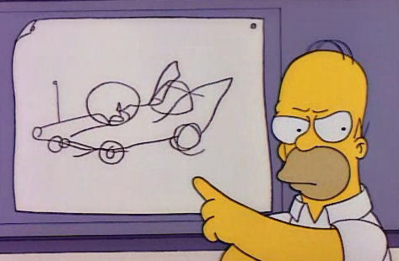


Slide 56


Slide 57
Reflect the world and the world will surprise you.

Slide 58
Discover unknown uses.

Slide 59
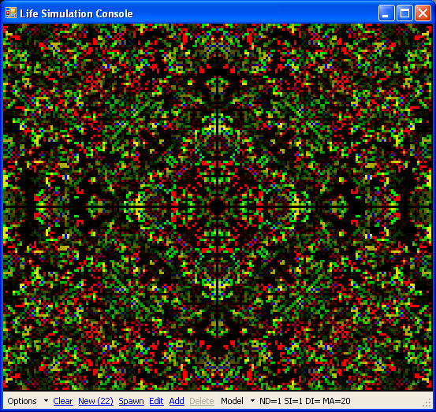

Slide 60


Slide 61
Small company vs. big company

Slide 62
Individual & Professional

Slide 63
Why does it matter what I believe?

Slide 64
Defined me and what I do.

Slide 65
Playing
Trading
Programming
Making

Slide 66
Inspire me

Slide 67
“So we need some standardization for data interchange among development tools and products. The more developers that adopt a standard, the better for all of us and our customers.”
-- Jerry Morrison, EA IFF 85

Slide 68


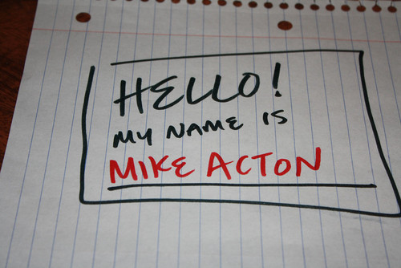

Slide 69
"Simple things should be simple and complex things should be possible."
-- Alan Kay

Slide 70
Color all of my choices every single day

Slide 71
Why are you here now?

Slide 72
So…what do I believe?

Slide 73
I Believe…
Games are important.
Games make a difference.
Games are art.
Games as pop.
Innovation by degrees.

Slide 74
What ELSE do I believe?

Slide 75
Engines enable

Slide 76
Reflect developers’ vision

Slide 77
Technology-driven industry cycle
Experimental (One person only)
Sophisticated (Many people)
Simple (Combine, disruptive, chaos)
Ubiquitous
Experimental (One person can)

Slide 78
The Programmer Bias

Slide 79
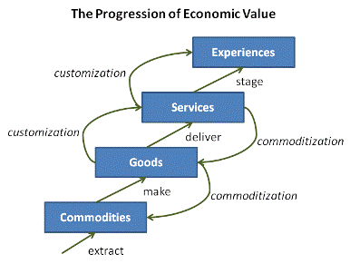
Games, for sure.
Joseph Pine, The Experience Economy

Slide 80
(For developers)
Joseph Pine, The Experience Economy

Slide 81
(For developers)
In hardware
Joseph Pine, The Experience Economy

Slide 82
(For developers)
Programmers
Joseph Pine, The Experience Economy

Slide 83
(For developers)
Basic
Tools
Joseph Pine, The Experience Economy

Slide 84
(For developers)
Make it happen!
Joseph Pine, The Experience Economy

Slide 85
Negativity Bias

Slide 86
Realtime

Slide 87
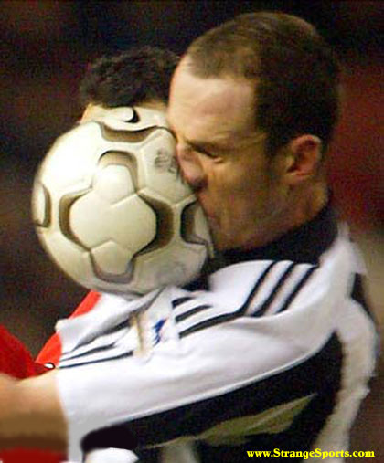
Realtime = Reflect player choice

Slide 88


Slide 89
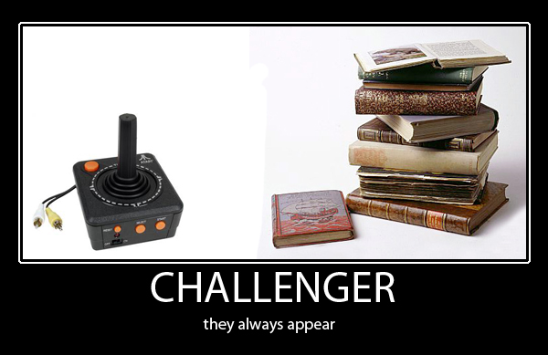

Slide 90
Post
Shaders
Camera
Environment
How else can you reflect players’ choices?

Slide 91
The uncanny valley

Slide 92
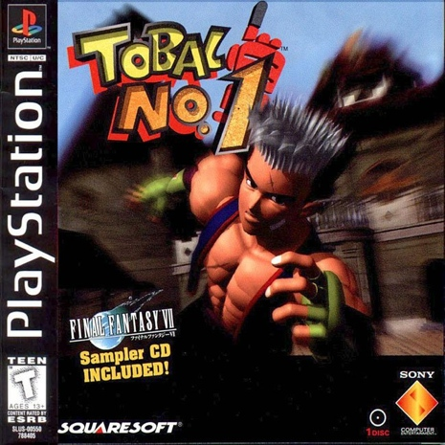

Slide 93
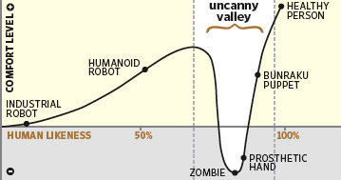
We are here

Slide 94
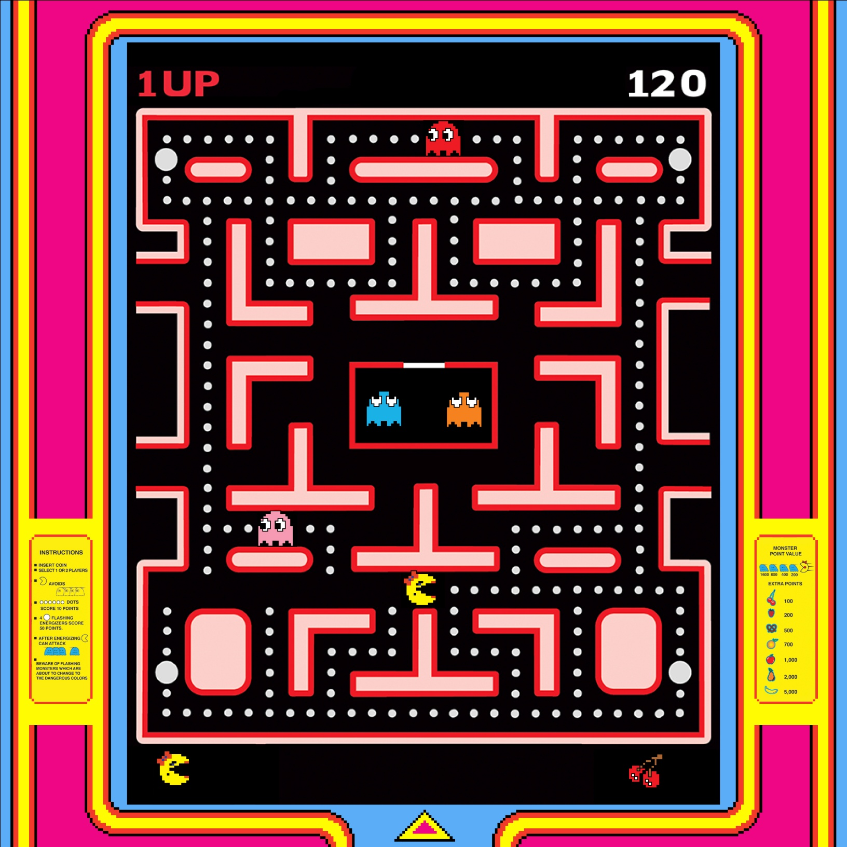

Slide 95
Usability

Slide 96
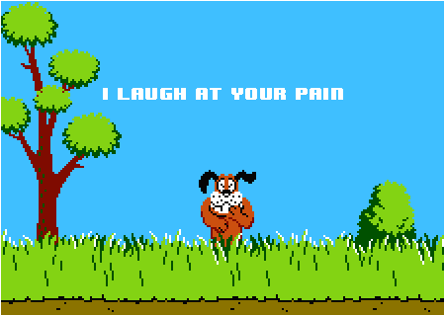

Slide 97
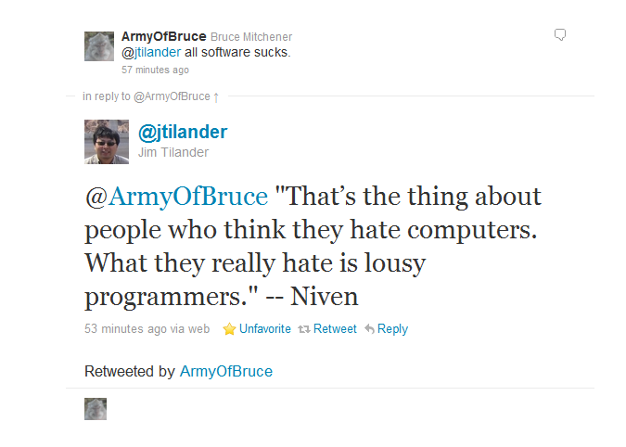

Slide 98
Usability cart stories

Slide 99
Feedback

Slide 100
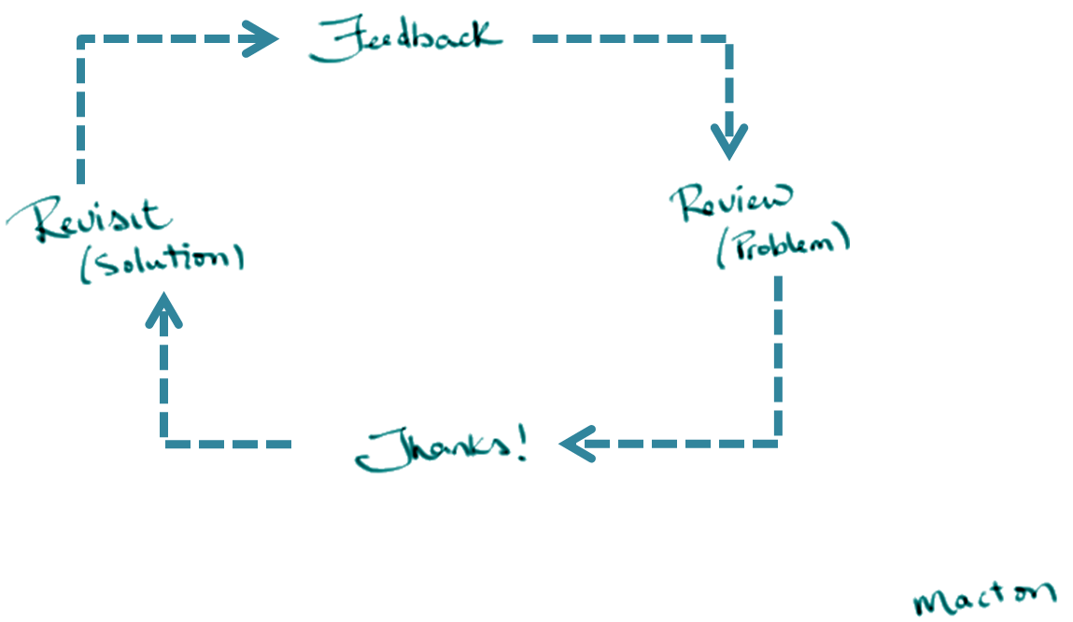

Slide 101
Performance

Slide 102
“Never underestimate the power of speed.”
-- Eric Schmidt, CEO of Google

Slide 103
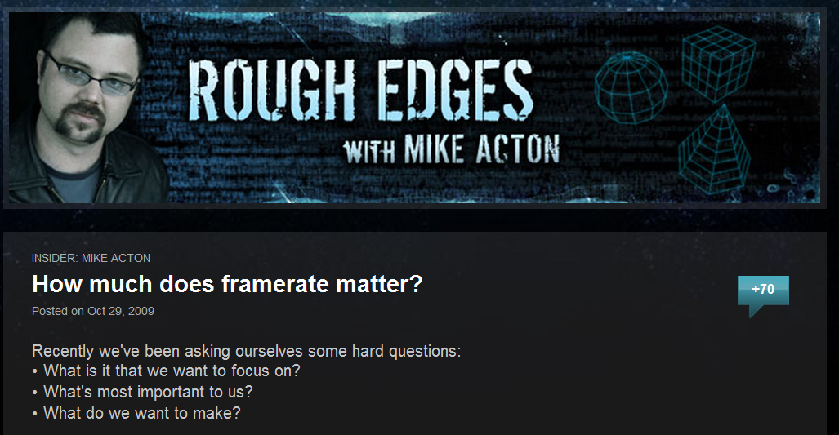
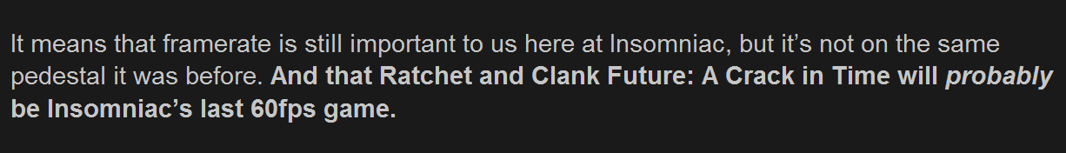

Slide 104
Hardware

Slide 105
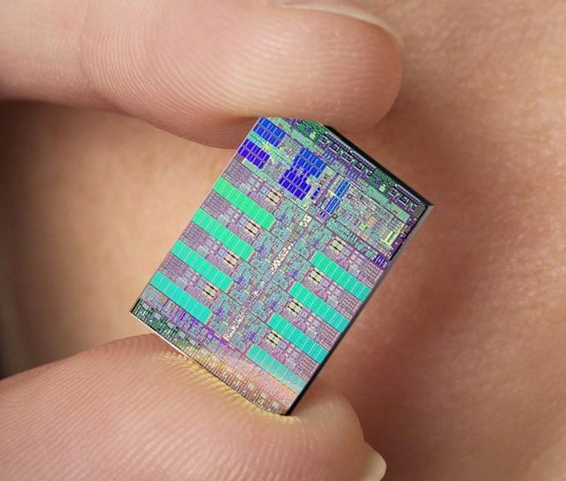

Slide 106
Data

Slide 107
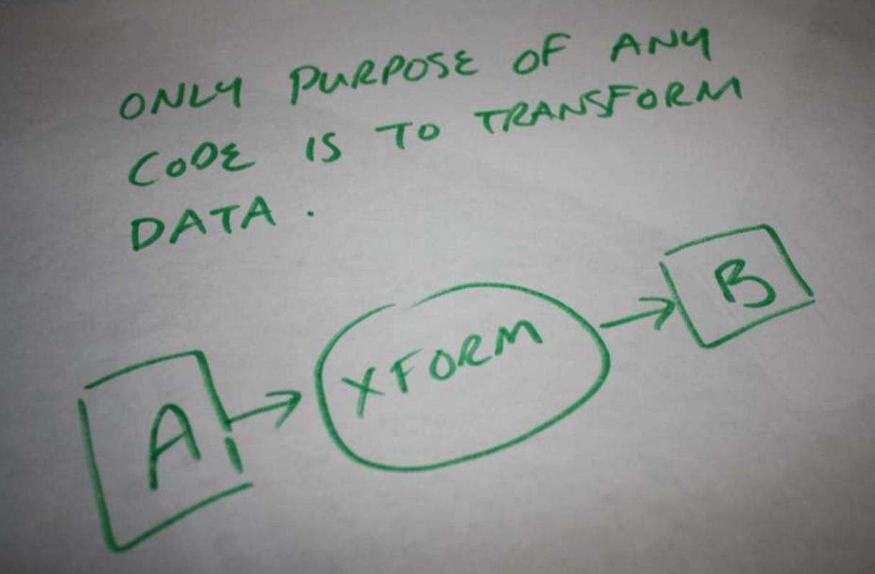

Slide 108
I Believe …
Games are important.
Games make a difference.
Games are art.
Games as pop.
Innovation by degrees.
Engines enable.
Realtime.
Usability
Feedback.
Performance.
Hardware.
Data.

Slide 109
Anything Else?

Slide 110
Magic

Slide 111
Value in magic

Slide 112
The magic of the unexpected

Slide 113
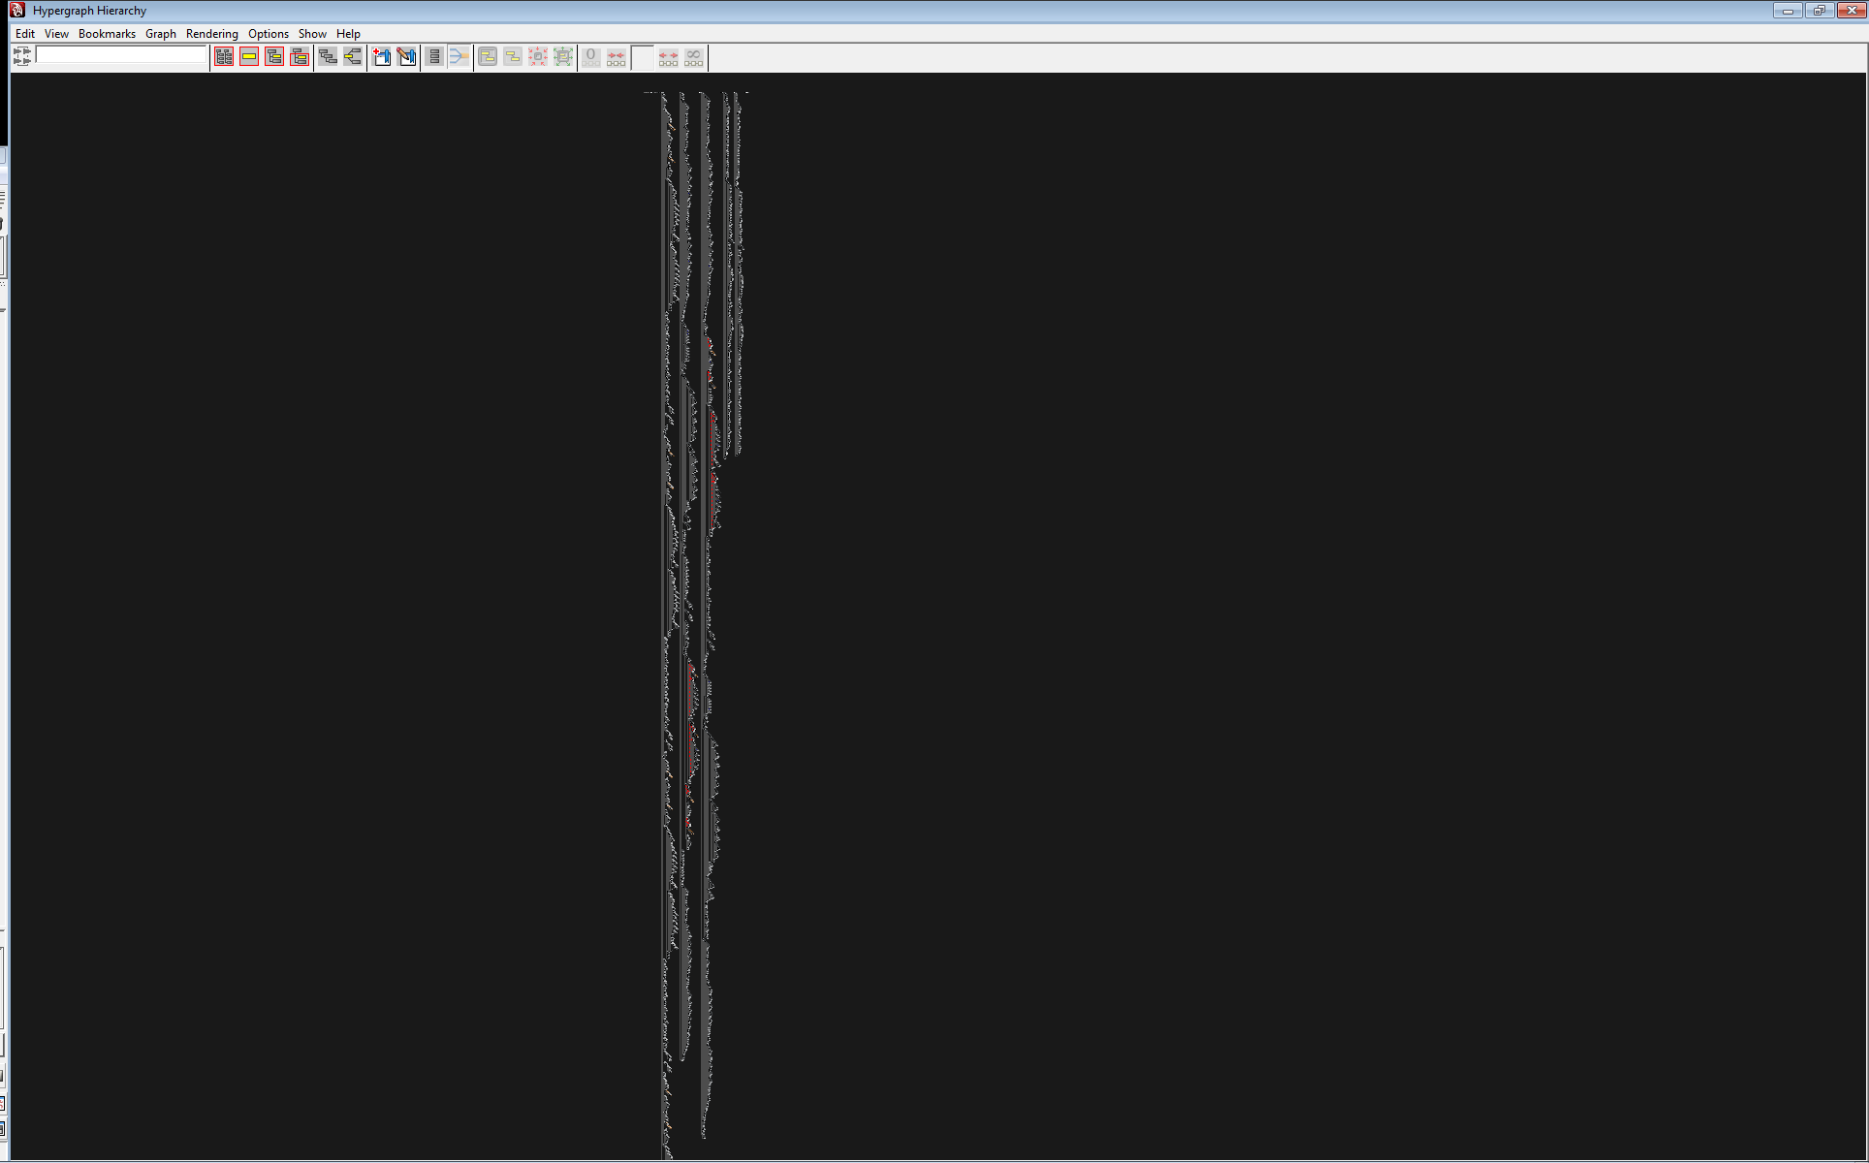

Slide 114
The magic of play

Slide 115
The magic of failure

Slide 116
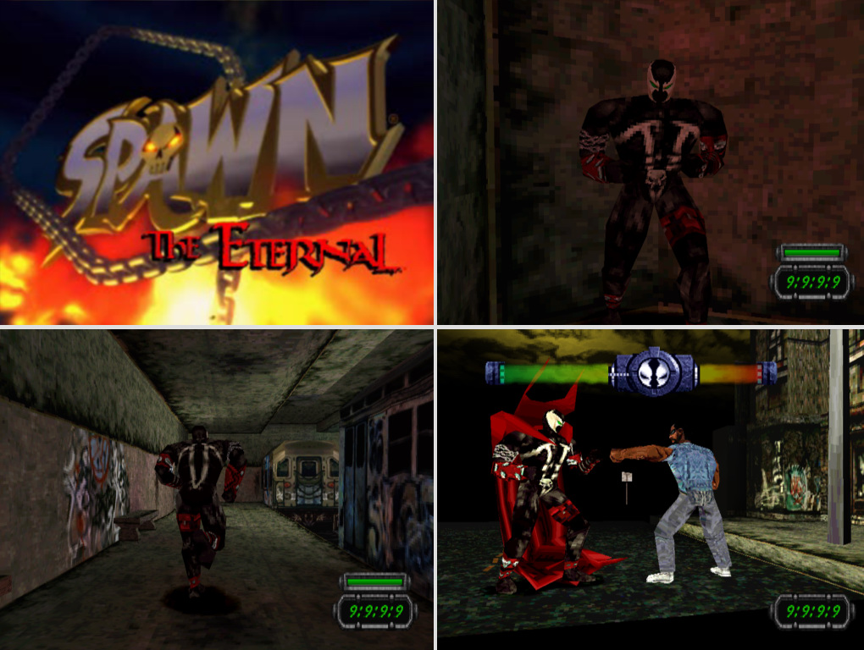

Slide 117
You failed. Try again?

Slide 118
“If you don't fail at least 90 percent of the time, you're not aiming high enough.”
-- Alan Kay

Slide 119
The magic of one person

Slide 120

Everyday Shooter, Jonathan Mak

Slide 121
Impact on a team

Slide 122
Our job is what we make it.

Slide 123
Prediction: 50% - 5 years 100% - 10 years

Slide 124
Growth (2x)

Slide 125
I Believe …
Games are important.
Games make a difference.
Games are art.
Games as pop.
Innovation by degrees.
Engines enable.
Realtime.
Usability
Feedback.
Performance.
Hardware.
Data.
Magic.

Slide 126
Why are you here?

Slide 127
Knowing what’s drives me.

Slide 128
Breaking the rules

Slide 129
Making mistakes

Slide 130
Being curious

Slide 131
Asking questions

Slide 132
Finding alternatives

Slide 133
Having fun

Slide 134
The data.

Slide 135
Be a real person
passions
choices

Slide 136
I Believe …
Games are important.
Games make a difference.
Games are art.
Games as pop.
Innovation by degrees.
Engines enable.
Realtime.
Usability
Feedback.
Performance.
Hardware.
Data.
Magic.
Why?

Slide 137
I Believe …
Games are important.
Games make a difference.
Games are art.
Games as pop.
Innovation by degrees.
Engines enable.
Realtime.
Usability
Feedback.
Performance.
Hardware.
Data.
Magic.
How?

Slide 138
I Believe …
Games are important.
Games make a difference.
Games are art.
Games as pop.
Innovation by degrees.
Engines enable.
Realtime.
Usability
Feedback.
Performance.
Hardware.
Data.
Magic.
What?

Slide 139

Vehicle for passion

Slide 140

I’m taking action!

Slide 141
?
???
macton@insomniacgames.com

